Slide 1
Chapter 7. Statistical Intervals Based on a Single Sample
Weiqi Luo (骆伟祺)
School of Software
Sun Yat-Sen University
Email：weiqi.luo@yahoo.com Office：# A313

Slide 2
Chapter 7: Statistical Intervals Based on A Single Sample
7.1. Basic Properties of Confidence Intervals
7.2. Larger-Sample Confidence Intervals for a Population Mean and Proportion
7.3 Intervals Based on a Normal Population Distribution
7.4 Confidence Intervals for the Variance and Standard Deviation of a Normal Population

Slide 3
Chapter 7 Introduction
Introduction
A point estimation provides no information about the precision and reliability of estimation.
For example, using the statistic X to calculate a point estimate for the true average breaking strength (g) of paper towels of a certain brand, and suppose that X = 9322.7. Because of sample variability, it is virtually never the case that X = μ. The point estimate says nothing about how close it might be to μ.
An alternative to reporting a single sensible value for the parameter being estimated is to calculate and report an entire interval of plausible values—an interval estimate or confidence interval (CI)

Slide 4
7.1 Basic Properties of Confidence Intervals
Considering a Simple Case
Suppose that the parameter of interest is a population mean μ and that
The population distribution is normal.
The value of the population standard deviation σ is known
Normality of the population distribution is often a reasonable assumption.
If the value of μ is unknown, it is implausible that the value of σ would be available.
In later sections, we will develop methods based on less restrictive assumptions.

Slide 5

7.1 Basic Properties of Confidence Intervals
Example 7.1
Industrial engineers who specialize in ergonomics are concerned with designing workspace and devices operated by workers so as to achieve high productivity and comfort. A sample of n = 31 trained typists was selected , and the preferred keyboard height was determined for each typist. The resulting sample average preferred height was 80.0 cm. Assuming that preferred height is normally distributed with σ = 2.0 cm. Please obtain a CI for μ, the true average preferred height for the population of all experienced typists.
Consider a random sample X₁, X₂, … X_{n} from the normal distribution with mean value μ and standard deviation σ . Then according to the proposition in pp. 245, the sample mean is normally distribution with expected value μ and standard deviation

Slide 6
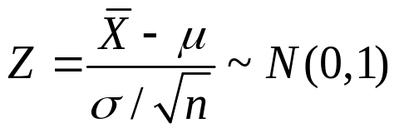
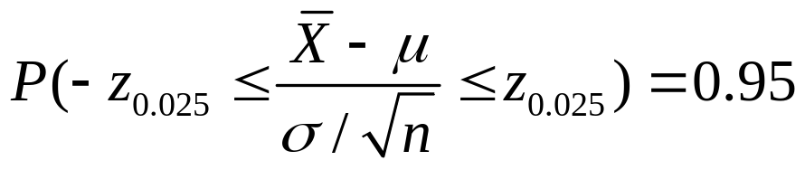

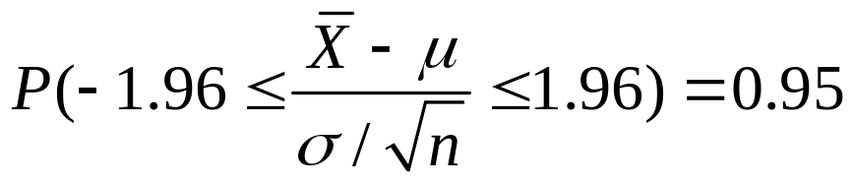
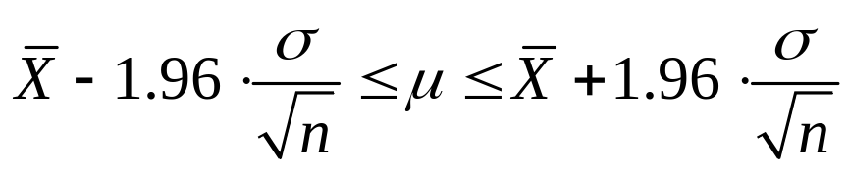
7.1 Basic Properties of Confidence Intervals
Example 7.1 (Cont’)
we have

Slide 7




7.1 Basic Properties of Confidence Intervals
Example 7.1 (Cont’)
True value of μ (Fixed)
CI (Random)
The CI of 95% is:
Interval number with different sample means
(1)
(2)
(3)
(4)
(5)
(6)
(7)
(8)
Interpreting a CI: It can be paraphrased as “the probability is 0.95 that the random interval includes or covers the true value of μ.
(9)
(10)
(11)
…

Slide 8

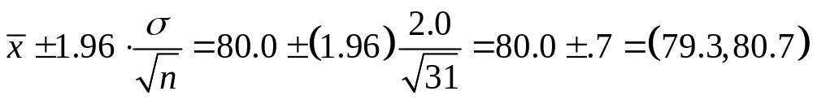
7.1 Basic Properties of Confidence Intervals
Example 7.2 (Ex. 7.1 Cont’)
The quantities needed for computation of the 95% CI for average preferred height are δ=2, n=31and . The resulting interval is
That is, we can be highly confident that 79.3 < μ < 80.7. This interval is relatively narrow, indicating that μ has been rather precisely estimated.

Slide 9

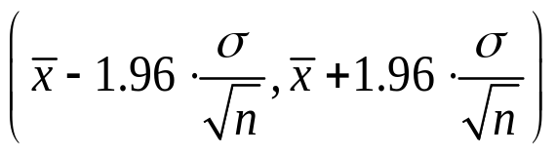
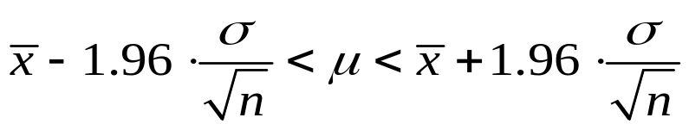
7.1 Basic Properties of Confidence Intervals
Definition
If after observing X₁=x₁, X₂=x₂, … X_{n}=x_{n}, we compute the observed sample mean . The resulting fixed interval is called a 95% confidence interval for μ. This CI can be expressed either as
or as
is a 95% CI for μ
with a 95% confidence
Lower Limit
Upper Limit

Slide 10
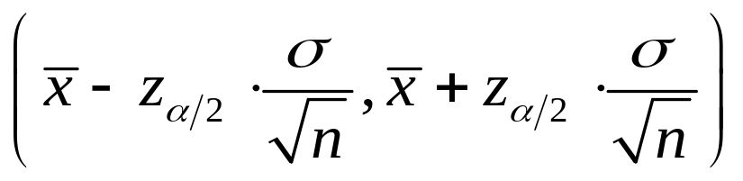
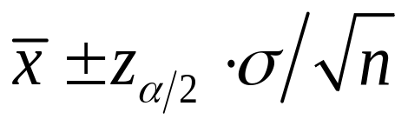
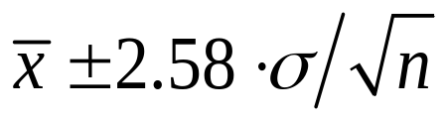
7.1 Basic Properties of Confidence Intervals
Other Levels of Confidence
A 100(1- α)% confidence interval for the mean μ of a normal population when the value of σ is known is given by
or,
For instance, the 99% CI is
Why is Symmetry?
Refer to pp. 291 Ex.8
P(a<z<b) = 1-α
Refer to pp.164 for the Definition Z_{α}
1-α
-z_{α/2}
0
+z_{α/2}

Slide 11
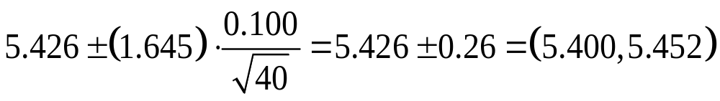
7.1 Basic Properties of Confidence Intervals
Example 7.3
Let’s calculate a confidence interval for true average hole diameter using a confidence level of 90%.
This requires that 100(1-α) = 90, from which α = 0.1 and z_{α/2} = z_{0.05} = 1.645. The desired interval is then

Slide 12
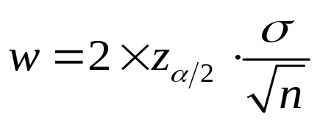
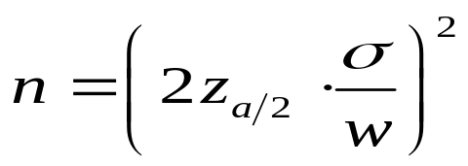
7.1 Basic Properties of Confidence Intervals
Confidence Level, Precision, and Choice of Sample Size
Then the width (Precision) of the CI
Independent of the sample mean
Higher confidence level (larger z_{α/2} ) ➔ A wider interval
Reliability
Precision
Larger σ ➔ A wider interval
Smaller n ➔ A wider interval
Given a desired confidence level (α) and interval width (w), then we can
determine the necessary sample size n, by

Slide 13
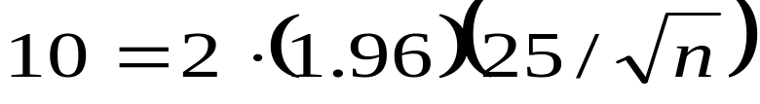
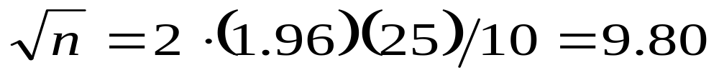
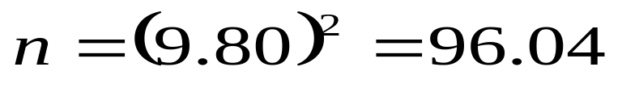
7.1 Basic Properties of Confidence Intervals
Example 7.4
Extensive monitoring of a computer time-sharing system has suggested that response time to a particular editing command is normally distributed with standard deviation 25 millisec. A new operating system has been installed, and we wish to estimate the true average response time μ for the new environment. Assuming that response times are still normally distributed with σ = 25, what sample size is necessary to ensure that the resulting 95% CI has a width of no more than 10? The sample size n must satisfy
Since n must be an integer, a sample size of 97 is required.

Slide 14
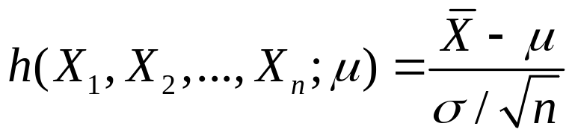
7.1 Basic Properties of Confidence Intervals
Deriving a Confidence Interval
In the previous derivation of the CI for the unknown population mean θ = μ of a normal distribution with known standard deviation σ, we have constructed the variable
Two properties of the random variable
depending functionally on the parameter to be estimated (i.e., μ)
having the standard normal probability distribution, which does not depend on μ.

Slide 15
7.1 Basic Properties of Confidence Intervals
The Generalized Case
Let X₁,X₂,…,X_{n} denote a sample on which the CI for a parameter θ is to be based. Suppose a random variable h(X₁,X₂,…,X_{n} ; θ) satisfying the following two properties can be found:
The variable depends functionally on both X₁,X₂,…,X_{n} and θ.
The probability distribution of the variable does not depend on θ or on any other unknown parameters.

Slide 16
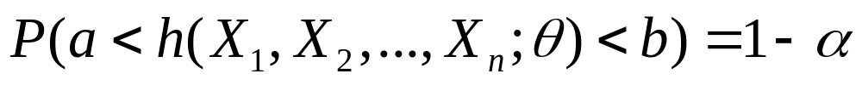
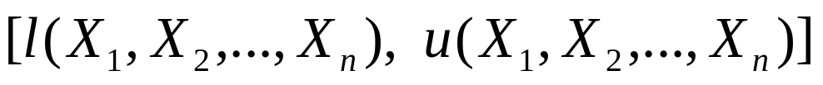

7.1 Basic Properties of Confidence Intervals
In order to determine a 100(1-α)% CI of θ, we proceed as follows:
Because of the second property, a and b do not depend on θ. In the normal example, we had a=-Z_{α/2} and b=Z_{α/2} Suppose we can isolate θ in the inequation:
In general, the form of the h function is suggested by examining the distribution of an appropriate estimator .
So a 100(1-α)% CI is

Slide 17




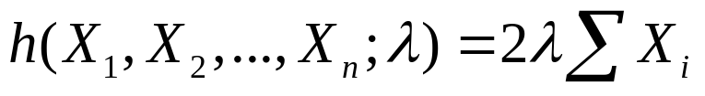
7.1 Basic Properties of Confidence Intervals
Example 7.5
A theoretical model suggest that the time to breakdown of an insulating fluid between electrodes at a particular voltage has an exponential distribution with parameter λ. A random sample of n = 10 breakdown times yields the following sample data :
A 95% CI for λ and for the true average breakdown time are desired.
It can be shown that this random variable has a probability distribution called a chi-squared distribution with 2n degrees of freedom. (Properties #2 & #1 )

Slide 18
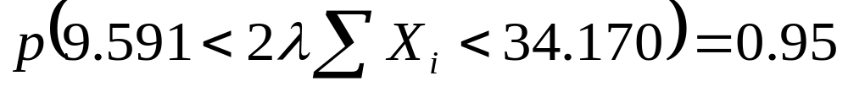
7.1 Basic Properties of Confidence Intervals
Example 7.5 (Cont’)
pp. 677 Table A.7
For the given data, Σx_{i} = 550.87, giving the interval (0.00871, 0.03101).
The 95% CI for the population mean of the breakdown time:

Slide 19
7.1 Basic Properties of Confidence Intervals
Homework
Ex. 1, Ex. 5, Ex. 8, Ex. 10

Slide 20
7.2 Large-Sample Confidence Intervals for a Population Mean and Proportion
The CI for μ given in the previous section assumed that the population distribution is normal and that the value of σ is known. We now present a large-sample CI whose validity does not require these assumptions.
Let X₁, X₂, … X_{n} be a random sample from a population having a mean μ and standard deviation σ (any population, normal or un-normal).
Provided that n is large (Large-Sample), the Central Limit Theorem (CLT) implies that X has approximately a normal distribution whatever the nature of the population distribution.

Slide 21
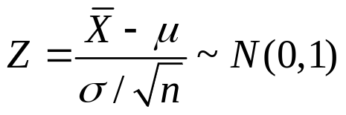
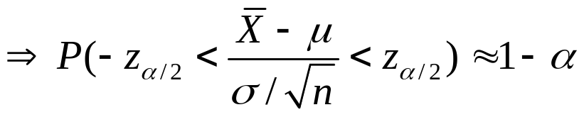
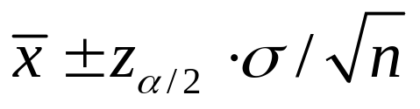

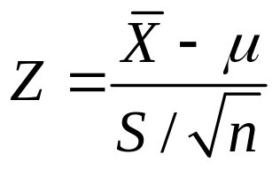

7.2 Large-Sample Confidence Intervals for a Population Mean and Proportion
Thus we have
Therefore, is a large-sample CI for μ with a
confidence level of approximately
That is , when n is large, the CI for μ given previously remains valid whatever the population distribution, provided that the qualifier “approximately” is inserted in front of the confidence level.
When σ is not known, which is generally the case, we may consider the following standardized variable

Slide 22
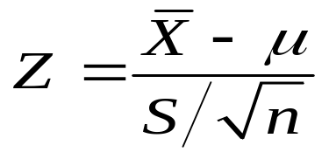
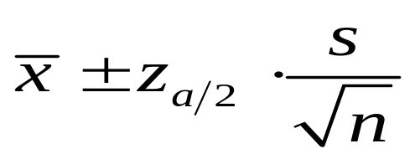

7.2 Large-Sample Confidence Intervals for a Population Mean and Proportion
Proposition
If n is sufficiently large (usually, n>40), the standardized variable
has approximately a standard normal distribution, meaning that
is a large-sample confidence interval for μ with confidence level approximately 100(1-α)%.
Compared with (7.5) in pp.286
Note: This formula is valid regardless of the shape of the population distribution.

Slide 23
7.2 Large-Sample Confidence Intervals for a Population Mean and Proportion
Example 7.6
The alternating-current breakdown voltage of an insulating liquid indicates its dielectric strength. The article “test practices for the AC breakdown voltage testing of insulation liquids,” gave the accompanying sample observations on breakdown voltage of a particular circuit under certain conditions.
62 50 53 57 41 53 55 61 59 64 50 53 64 62 50 68
54 55 57 50 55 50 56 55 46 55 53 54 52 47 47 55
57 48 63 57 57 55 53 59 53 52 50 55 60 50 56 58

Slide 24
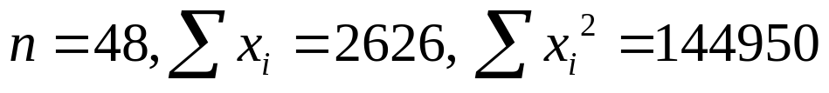

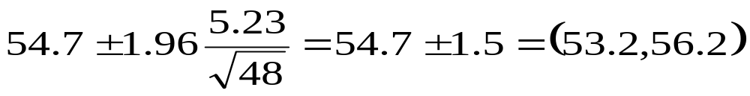
7.2 Large-Sample Confidence Intervals for a Population Mean and Proportion
Example 7.6 (Cont’)
55-41=14
68-55=13
Outlier
Voltage
40
50
60
70
Summary quantities include
The 95% confidence interval is then

Slide 25
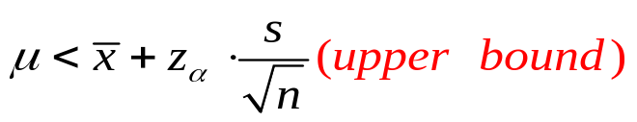
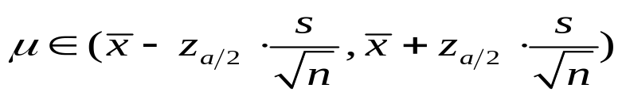
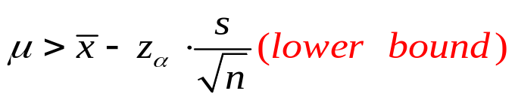
7.2 Large-Sample Confidence Intervals for a Population Mean and Proportion
One-Sided Confidence Intervals (Confidence Bounds)
So far, the confidence intervals give both a lower confidence bound and an upper bound for the parameter being estimated.
In some cases, we will want only the upper confidence or the lower one.
1-α
1-α
-z_{α}
-z_{α/2}
+z_{α/2}
Standard Normal Curve
1-α
Z _{α}

Slide 26
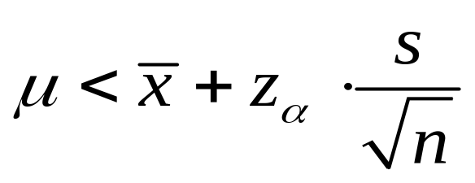
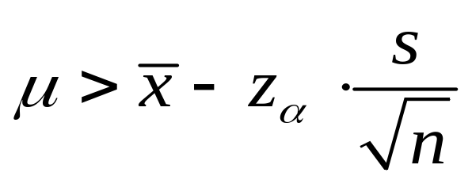
7.2 Large-Sample Confidence Intervals for a Population Mean and Proportion
Proposition
A large-sample upper confidence bound for μ is
and a large-sample lower confidence bound for μ is
Compared the formula (7.8) in pp.292

Slide 27
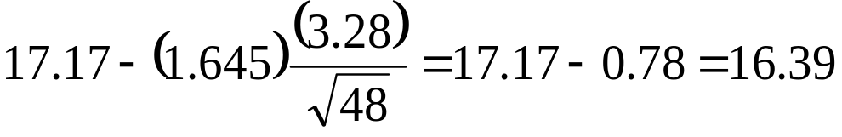
7.2 Large-Sample Confidence Intervals for a Population Mean and Proportion
Example 7.10
A sample of 48 shear strength observations gave a sample mean strength of 17.17 N/mm² and a sample standard deviation of 3.28 N/mm².
Then A lower confidence bound for true average shear strength μ with confidence level 95% is
Namely, with a confidence level of 95%, the value of μ lies in the interval (16.39, ∞).

Slide 28
7.2 Large-Sample Confidence Intervals for a Population Mean and Proportion
Homework
Ex. 12, Ex. 15, Ex. 16

Slide 29
7.3 Intervals Based on a Normal Population Distribution
The CI for μ presented in the previous section is valid provided that n is large. The resulting interval can be used whatever the nature of the population distribution (with unknown μ and σ).
If n is small, the CLT can not be invoked. In this case we should make a specific assumption.
Assumption
The population of interest is normal, X₁, X₂, … X_{n} constitutes a random sample from a normal distribution with both μ and δ unknown.

Slide 30
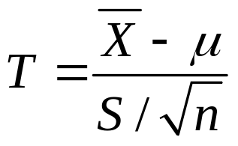

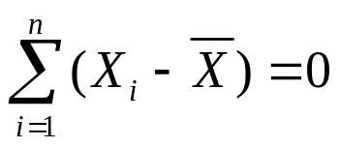
7.3 Intervals Based on a Normal Population Distribution
Theorem
When X is the mean of a random sample of size n from a normal distribution with mean μ. Then the rv
has a probability distribution called a t distribution with n-1 degrees of freedom (df) .
only n-1 of these are “freely determined”
S is based on the n deviations
Notice that

Slide 31
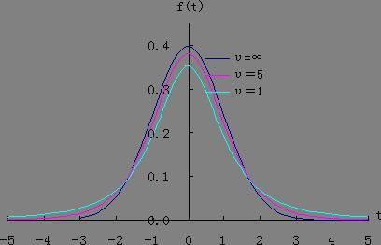
7.3 Intervals Based on a Normal Population Distribution
Properties of t Distributions
The only one parameter in T is the number of df: v=n-1
Let t_{v} be the density function curve for v df
1. Each t_{v} curve is bell-shaped and centered at 0.
2. Each t_{v} curve is more spread out than the
standard normal curve.
3. As v increases, the spread of the
corresponding t_{v} curve decreases.
4. As v→ ∞, the sequence of t_{v} curves
approaches the standard normal curve N(0,1) .
Rule: v ≥ 40 ~ N(0,1)

Slide 32
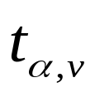
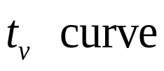

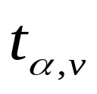

7.3 Intervals Based on a Normal Population Distribution
Notation
Let = the value on the measurement axis for which the area under the t curve with v df to the right of is α; is called a t critical value
Fixed α, v ,
Fixed v, α ,
0
Figure 7.7 A pictorial definition of
Refer to pp.164 for the similar definition of Z_{α}

Slide 33
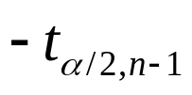
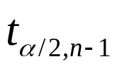

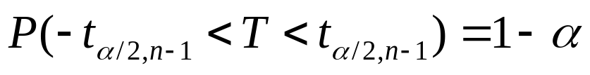
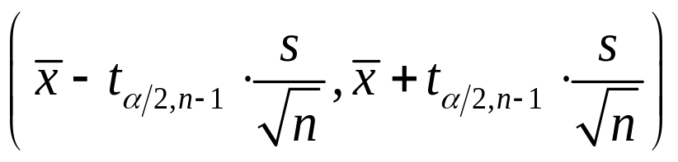
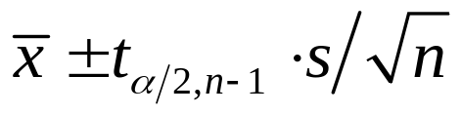

7.3 Intervals Based on a Normal Population Distribution
The One-Sample t confidence Interval
The standardized variable T has a t distribution with n-1 df, and the area under the corresponding t density curve between
and
is , so
Proposition: Let x and s be the sample mean and sample standard deviation computed from the results of a random sample from a normal population with mean μ. Then a 100(1-α)% confidence interval for μ is
Or, compactly
An upper confidence bound with 100(1-α)% confidence level for μ is . Replacing + by – gives a lower confidence bound for μ.
Compared with the propositions in pp 286, 292 & 297

Slide 34
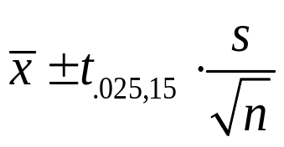
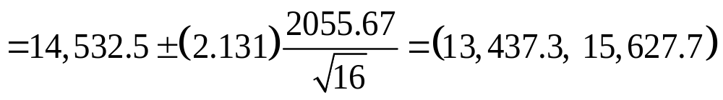
7.3 Intervals Based on a Normal Population Distribution
Example 7.11
Consider the following observations
1. approximately normal by observing the probability plot.
2. n = 16 is small, and the population deviation σ is unknown, so we choose the statistic T with a t distribution of n – 1 = 15 df. The resulting 95% CI is
10490 16620 17300 15480 12970 17260 13400 13900
13630 13260 14370 11700 15470 17840 14070 14760

Slide 35
7.3 Intervals Based on a Normal Population Distribution
A Prediction Interval for a Single Future Value
Estimation the population
parameter, e.g. μ
(Point Estimation)
Deriving a Confidence Interval (CI) for
the population parameter, e.g. μ
(Confidence Interval)
Population with unknown parameter
Given a random sample
of size n from the population
X₁, X₂, …, X_{n}
Deriving a Confidence Interval for
a new arrival X_{n+1}
(Prediction Interval)

Slide 36
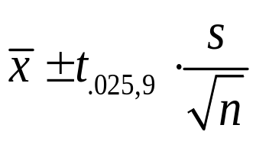
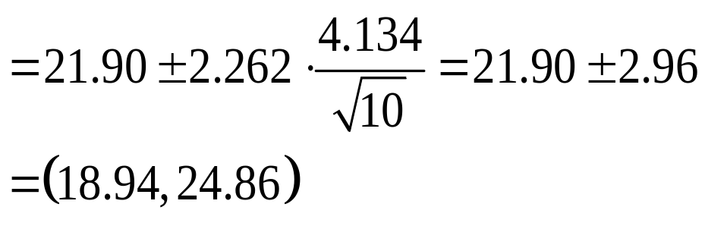
7.3 Intervals Based on a Normal Population Distribution
Example 7.12
Consider the following sample of fat content (in percentage) of n = 10 randomly selected hot dogs
Assume that these were selected from a normal population distribution.
Please give a 95% CI for the population mean fat content.
25.2 21.3 22.8 17.0 29.8 21.0 25.5 16.0 20.9 19.5

Slide 37

7.3 Intervals Based on a Normal Population Distribution
Example 7.12 (Cont’)
Suppose, however, we are only interested in predicting the fat content of the next hot dog in the previous example. How would we proceed?
Point Estimation (point prediction):
Can not give any information on reliability or precision.

Slide 38






7.3 Intervals Based on a Normal Population Distribution
Prediction Interval (PI)
Let the fat content of the next hot dog be X_{n+1}. A sensible point predictor is . Let’s investigate the prediction error .
is a normal rv with
Why?
and

Slide 39



7.3 Intervals Based on a Normal Population Distribution
Example 7.12 (Cont’)
unknown
~ t distribution with n-1 df

Slide 40

7.3 Intervals Based on a Normal Population Distribution
Proposition
A prediction interval (PI) for a single observation to be
selected from a normal population distribution is
The prediction level is 100(1-α)%

Slide 41


7.3 Intervals Based on a Normal Population Distribution
Example 7.13 (Ex. 7.12 Cont’)
With n=10, sample mean is 21.90, and t_{0.025,9}=2.262, a 95% PI for the fat content of a single hot dog is

Slide 42
7.3 Intervals Based on a Normal Population Distribution
True value of μ (Fixed)
A New Arrival X_{n+1} (Random)
CI (Random)
PI (Random)
(1)
(1)
(2)
(2)
(3)
(3)
(4)
(4)
(5)
(5)
(6)
(6)
(7)
(7)
(8)
(8)
(9)
(9)
(10)
(10)
(11)
(11)
There is more variability in the PI than in CI due to X_{n+1}

Slide 43
7.3 Intervals Based on a Normal Population Distribution
Homework
Ex. 32, Ex.33

Slide 44

7.4 Confidence Intervals for the Variance and Standard Deviation of a Normal Population
In order to obtain a CI for the variance σ² of a normal distribution, we start from its point estimator, S²
Theorem
Let X₁, X₂, …, X_{n} be a random sample from a normal
distribution with parameter μ and σ² . Then the rv
has a chi-squared (χ²) probability distribution with n-1 df.
Note: The two properties for deriving a CI in pp. 288 are satisfied.

Slide 45




7.4 Confidence Intervals for the Variance and Standard Deviation of a Normal Population
The Distributions of χ²
Not a Symmetric Shape
Refer to Table A.7 in 677
x
Figure 7.9 Graphs of chi-squared density functions

Slide 46




7.4 Confidence Intervals for the Variance and Standard Deviation of a Normal Population
Chi-squared critical value χ²_{α,ν}
χ²_{ν} curve
Each shaded area = α/2
1- α

Slide 47


7.4 Confidence Intervals for the Variance and Standard Deviation of a Normal Population
Proposition
A 100(1- α)% confidence interval for the variance σ² of a normal population is
A confidence interval for σ is
v=n-1
Lower Limit
Upper Limit

Slide 48
7.4 Confidence Intervals for the Variance and Standard Deviation of a Normal Population
Example 7.15
The accompanying data on breakdown voltage of electrically stressed circuits was read from a normal probability plot. The straightness of the plot gave strong support to the assumption that breakdown voltage is approximately normally distributed .
1170 1510 1690 1740 1900 2000 2030 2100 2190
2200 2290 2380 2390 2480 2500 2580 2700
Let σ² denote the variance of the breakdown voltage distribution and it is unknown. Determine the 95% confidence interval of σ².

Slide 49

7.4 Confidence Intervals for the Variance and Standard Deviation of a Normal Population
Example 7.15 (Cont’)
The computed value of the sample variance is s² =137,324.3, the point estimate of σ². With df = n-1 =16, a 95% CI require χ²_{0.975,16} = 6.908 and χ²_{0.025,16} = 28.845. The interval is
Taking the square root of each endpoint yields (276.0,564.0) as the 95% CI for σ.

Slide 50
7.4 Confidence Intervals for the Variance and Standard Deviation of a Normal Population
Summary of Chapter 7
General method for deriving CIs (2 properties, p.288)
Case #1: (7.1)
CI for μ of a normal distribution with known σ;
Case #2: (7.2)
Large-sample CIs for μ of General distributions with unknown σ
Case #3: (7.3)
Small-sample CIs for μ of Gaussian distributions with unknown σ
Both Sided Vs. One-sided CIs (p.297)
PI (p.303) & CIs for σ² (7.4)

Slide 51
7.4 Confidence Intervals for the Variance and Standard Deviation of a Normal Population
Homework
Ex. 44

